Slide 1
Can Facebook Ads prevent malaria? Two field experiments in India
Dante Donati Nandan Rao Victor Orozco-Olvera Ana Maria Muñoz-Boudet
Columbia Business School Virtual Lab The World Bank The World Bank
Dante Donati
China India Insights Conference, Stanford Graduate School of Business
September 15, 2023

Slide 2
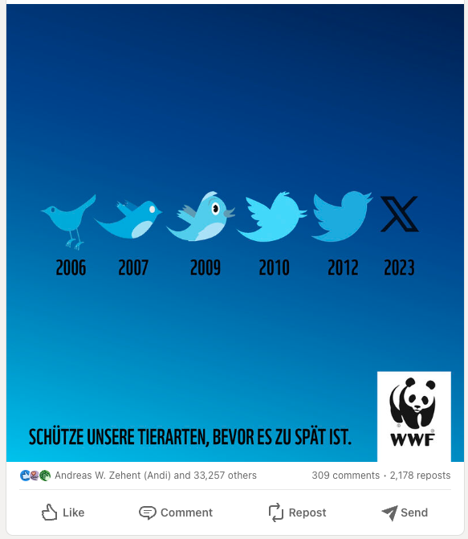
Motivation
Protect our animal species before it’s too late
Notes:
Campaign ingeniously employed the evolution of Twitter's blue bird logo from 2006 to 2023 to convey a powerful message about the endangerment of various animal species.
The graphic showcased the hypothetical extinction of these species, emphasizing the urgent need to protect them
Using LinkedIn as their platform of choice, McCann Germany shared the graphic, and within no time, it went viral. The visual stirred emotions across the globe, evoking a sense of mourning for the "loss" of the Twitter bird while underscoring the grim reality that approximately one million real animal species currently face the threat of extinction.

Slide 3
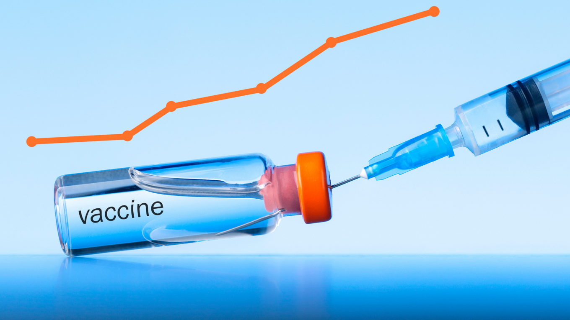
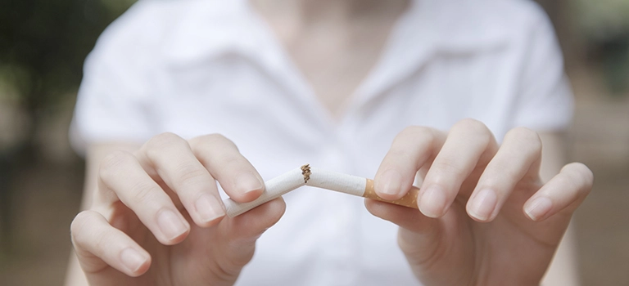
Motivation
Social media Ad campaigns are increasingly used for social good and public health objectives
Notes:
Campaigns with clear calls to actions
Think of them as PSAs with better personalization
understanding whether ad campaigns can change individuals’ beliefs, attitudes and real-world behaviors is difficult and requires the availability of longer-term outcomes that are not directly measurable on the ad platform itself.

Slide 4
But…what is the impact of such campaigns?
Effectiveness is measured via direct response metrics (likes, clicks) or short-term “brand-lift” surveys (Shawky et al. 2019; Athey et al. 2023)
Not always informative about the final goals of such campaigns
Measuring real-world impact requires random assignment of Ad + measures of long-term behaviors
Methodologically challenging and costly
Not commonly done
Notes:
understanding whether ad campaigns can change individuals’ beliefs, attitudes and real-world behaviors is difficult and requires the availability of longer-term outcomes that are not directly measurable on the ad platform itself.
Direct responses (clicks or downloads) are not indicative of actual behavior change
Because ads are algorithmically delivered, certain subpopulations can be more impacted than others
Costs are direct and indirect (opportunity cost of control group)

Slide 5
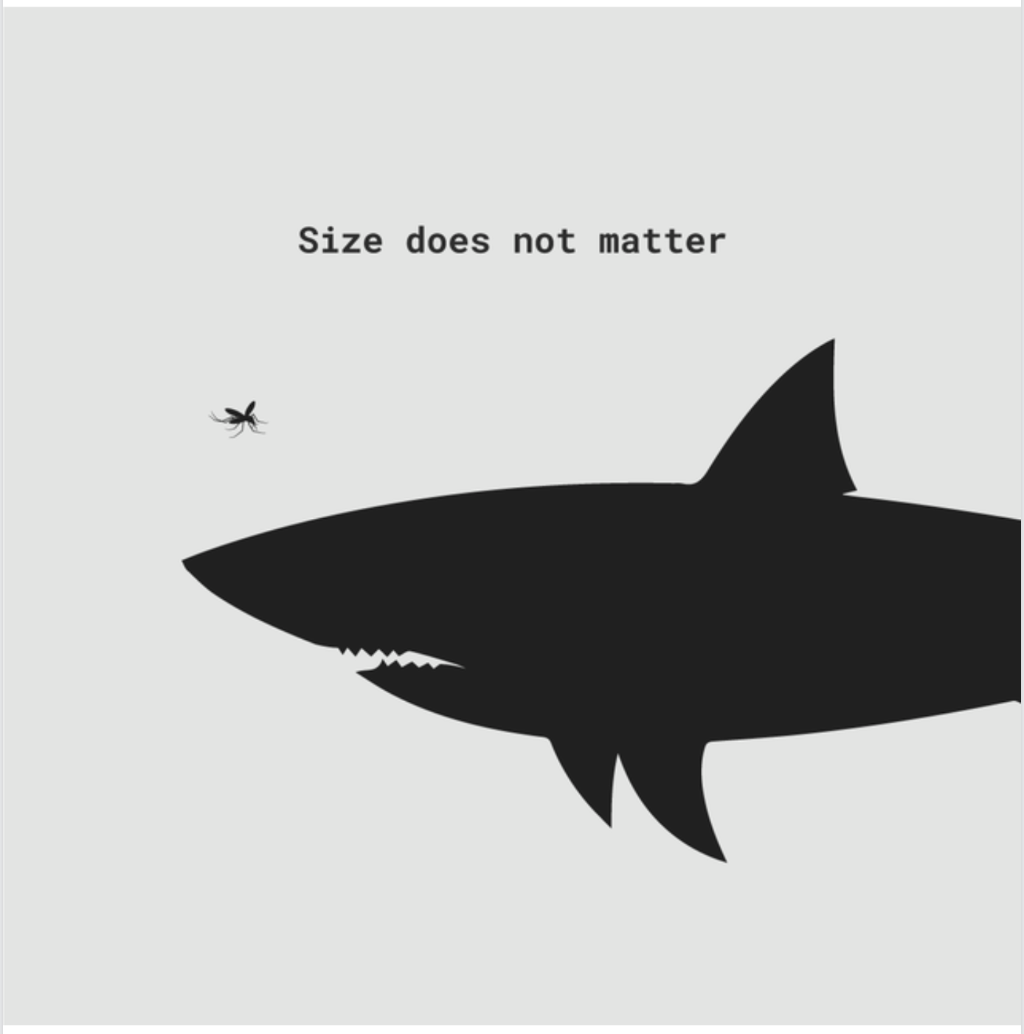
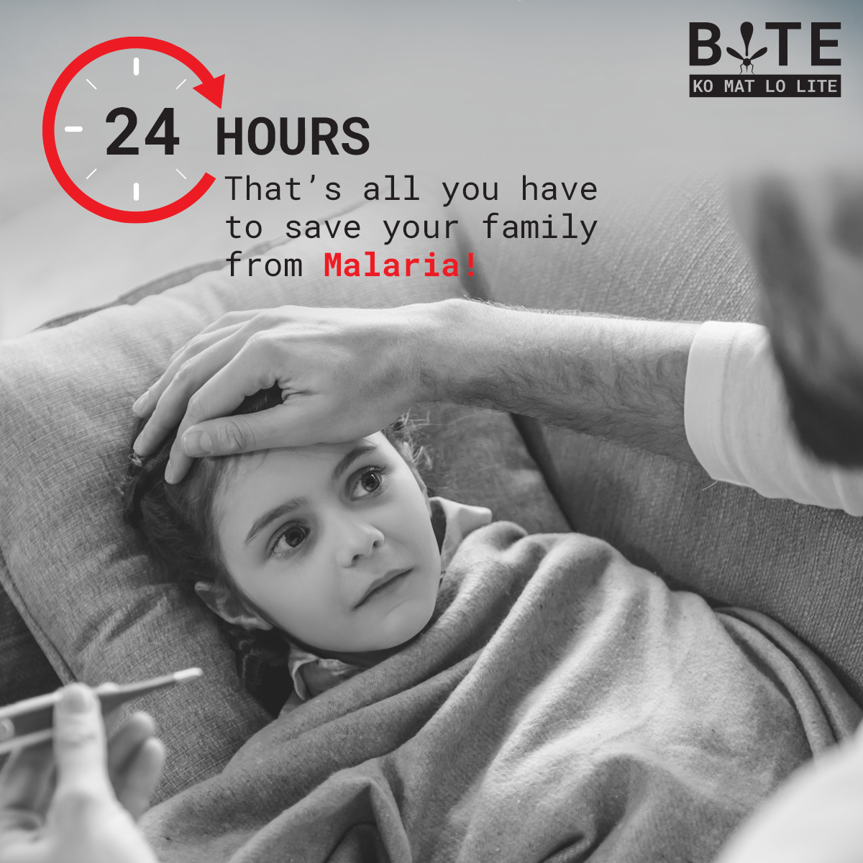
This paper
Employs a novel methodology and two field experiments to evaluate a malaria prevention Ad campaign on:
Preventative/Response behaviors
Long-term malaria incidence (1-5 months after exposure)
Investigates its heterogenous effects across subpopulations:
Sheds light on the mechanisms of targeting vs. content persuasiveness
Guides practitioners and organizations
Provides evidence on the importance of marketing (ads) to address social issues (Chandy et al. 2021)
Notes:
A disease caused by a plasmodium parasite, transmitted by the bite of infected mosquitoes.

Slide 6
Roadmap
The malaria prevention campaign
Study 1 - Campaign impact evaluation design and results
Study 2 - Mechanisms: targeting vs. persuasion
Cost-effectiveness and conclusions

Slide 7
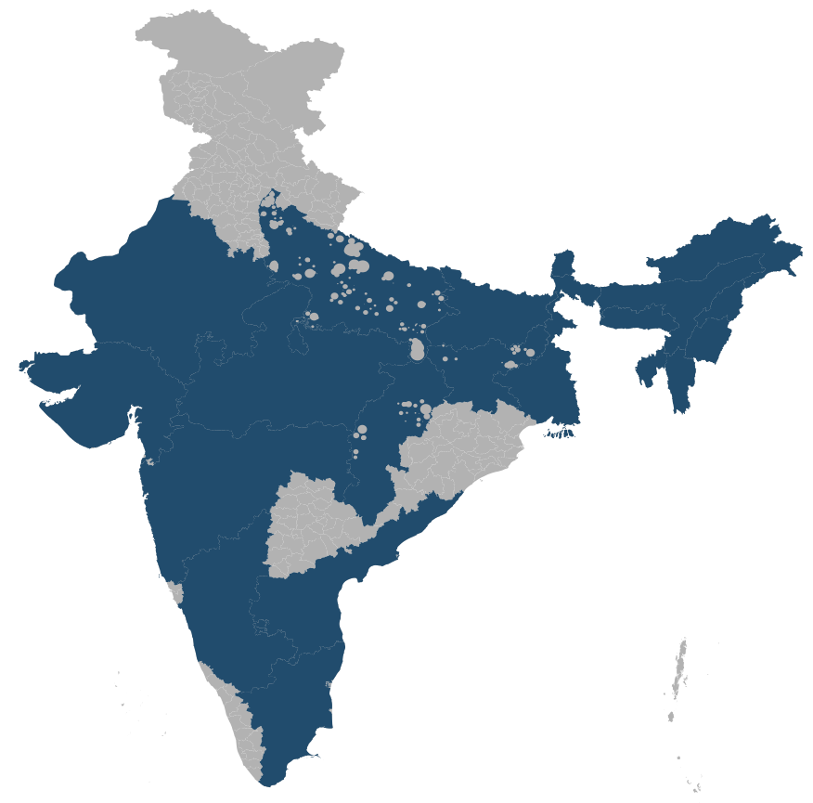
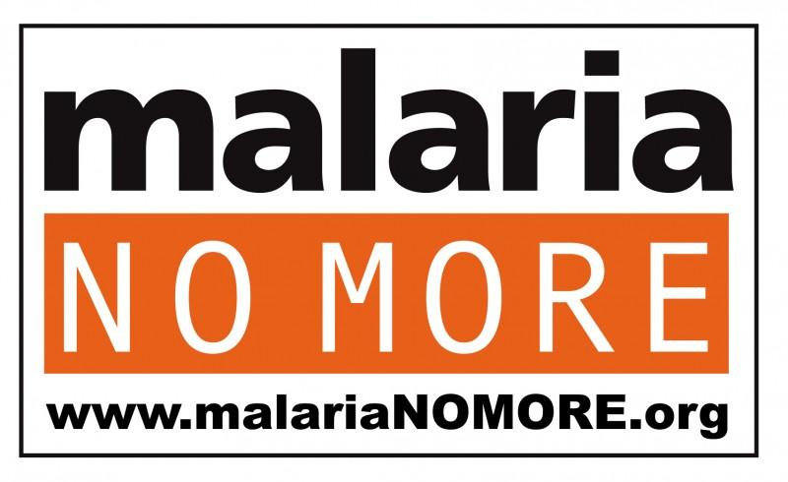
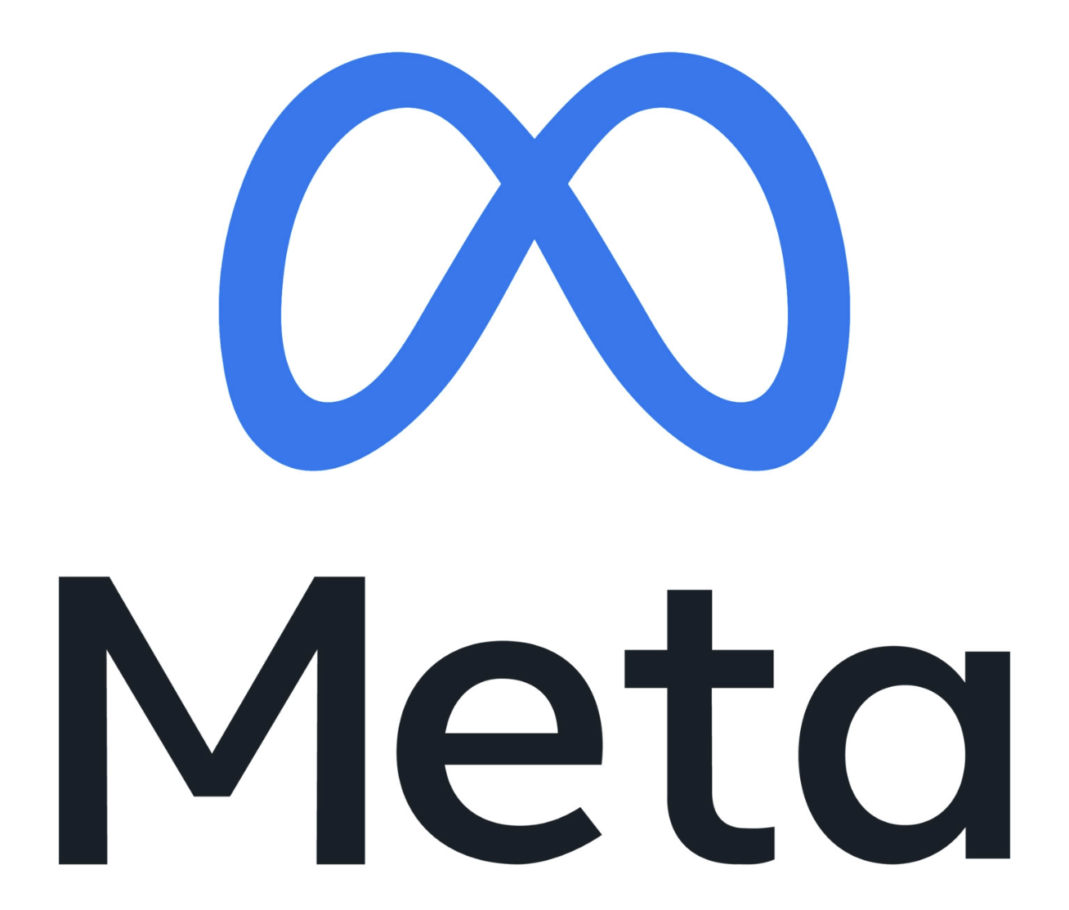


Malaria prevention Ad campaign in India
Malaria is widespread in India. In 2020: 4.1M estimated cases, 186K officially recorded
Rural incidence almost 2X larger than urban incidence
76% of HHs have mosquito nets, yet only 65% use them regularly → 50% of HHs are not protected
Nation-wide social marketing campaign on Facebook and Instagram
Goals: malaria awareness, protective behaviors and treatment seeking
General population in 22 states, from August 2020 to January 2021
202K USD ad spend
130M people reached (43% of FB users)
Avg. frequency: 2 impressions/user
Campaign objective: Engagement
Notes:
A disease caused by a plasmodium parasite, transmitted by the bite of infected mosquitoes.
disproportionately affects poor and rural populations
22 states: 1.2 B people, about 85% of total Indian pop
45M actions and reactions on the post
CPM: 1.6 USD

Slide 8
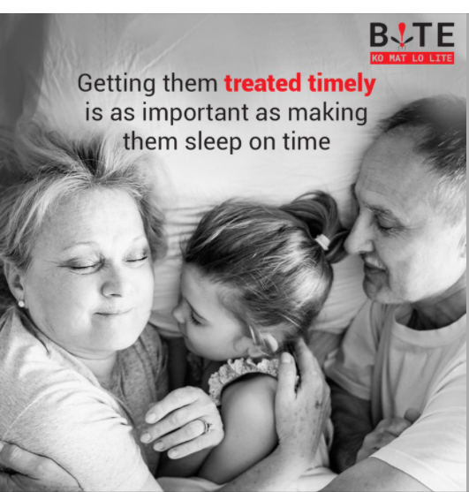
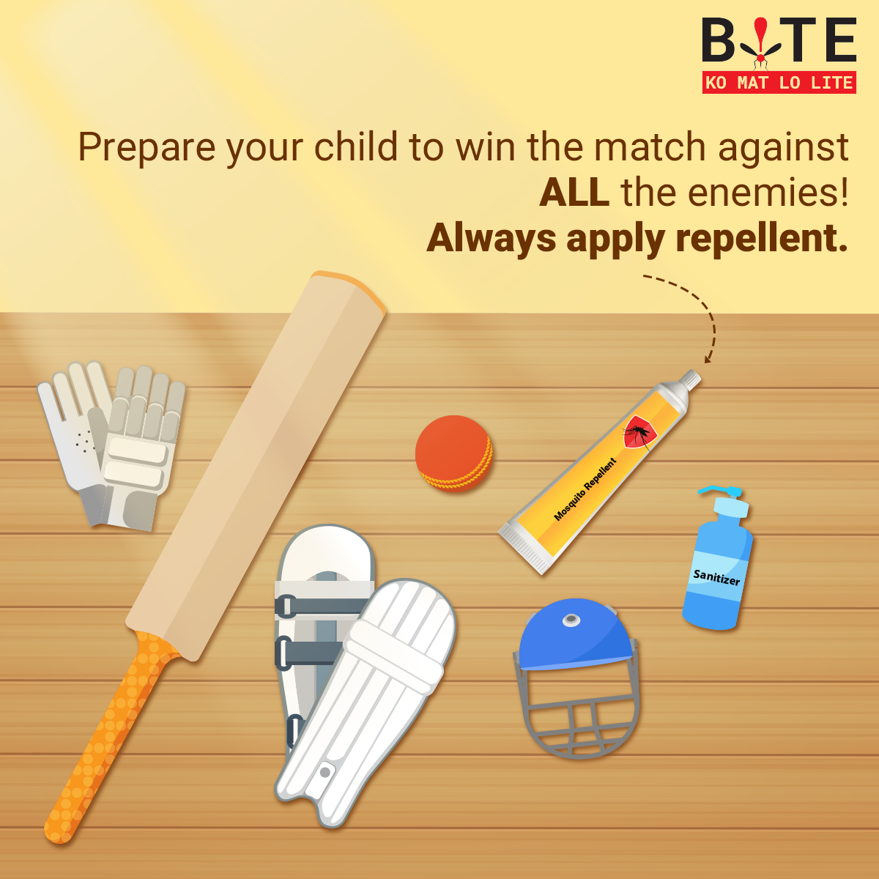
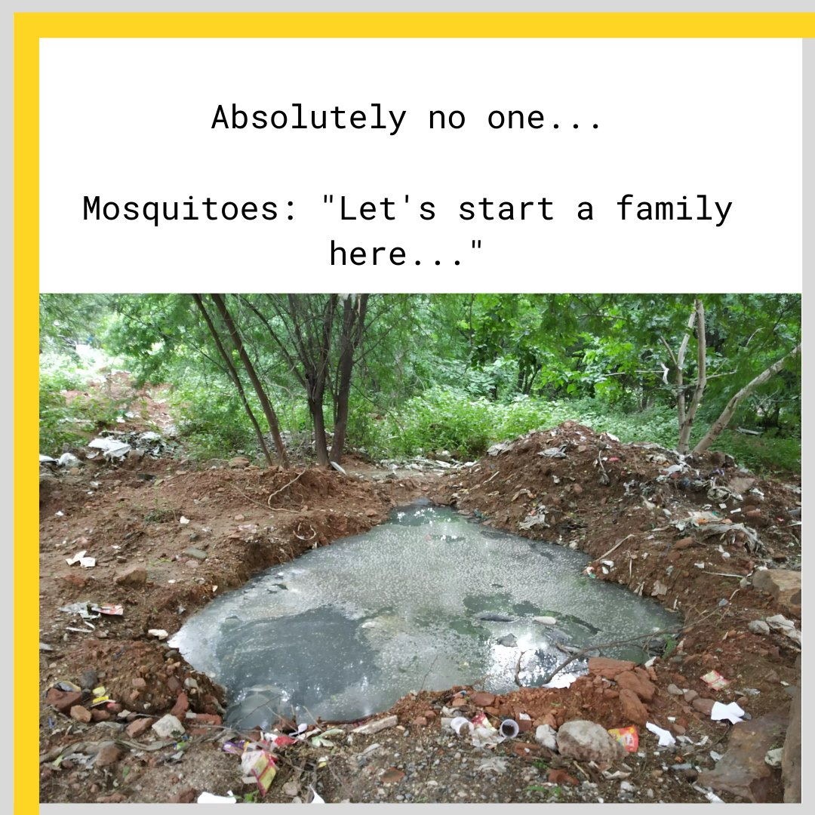
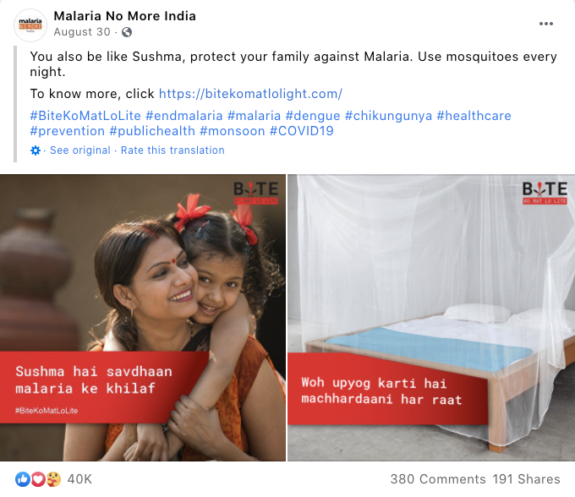
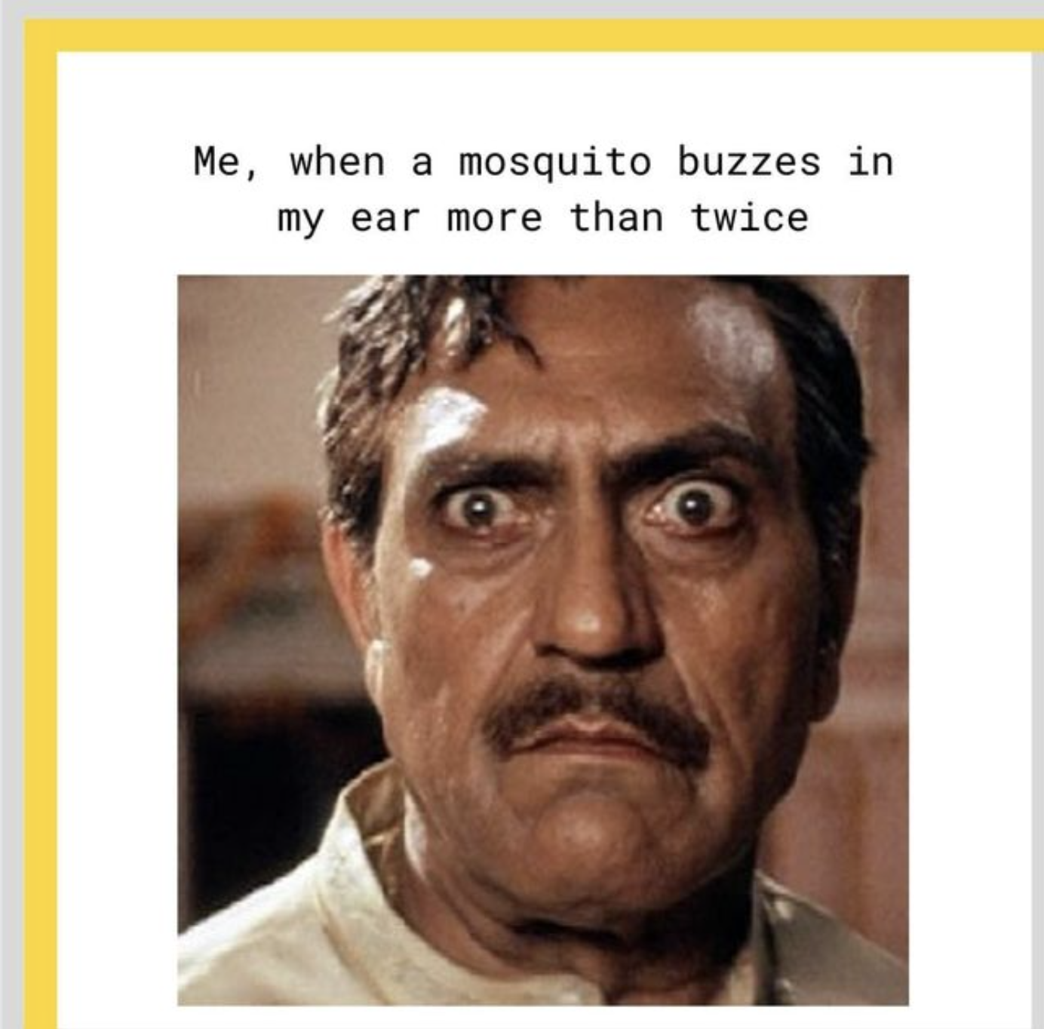
Ad content
50+ different creatives
Formative research to generate persona-specific content (e.g., gender, age, urban)
Notes:
For each persona, barriers to preventative and response behavior were identified, and content was developed based on insights from their online behavior. For example, for women, who tended to emphasize family and protection against mosquitoes, content focused on children and motherhood. For men, who were more focused on information, content focused on services (government, healthcare), symptoms and treatment. Younger audiences, especially in the 18-24 age bucket were targeted using meme-styled content and humor, and older individuals, received content that used their awareness and engagement with the topic to spread the word and advocate for prevention and response, for example, by encouraging grandparents to have their grandchildren tested if they experience malaria symptoms.

Slide 9
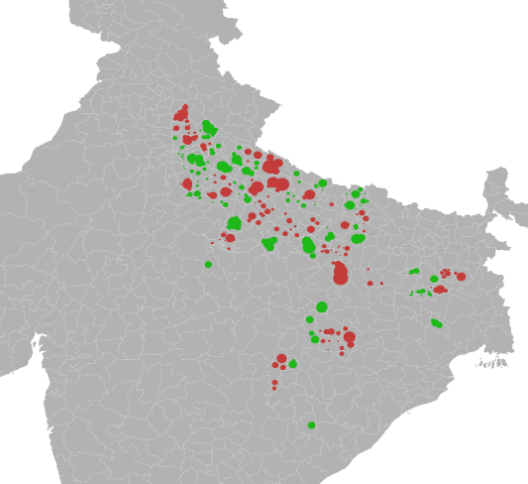
Study 1: Campaign impact evaluation design
3 holdout states (Uttar Pradesh, Chhattisgarh, Jharkhand)
80 districts with high FB/IG penetration
Cluster-randomization at district level (balancing on covariates)
Self-reported and objective outcomes:
Recruit stratified sample of participants using targeted ads (Virtual Lab engine; Rao and Donati 2023)
Surveys through chatbot on Messenger (n=5,500)
Administrative health facility data
Control districts (no Ads)
Treatment districts (Ads)
Notes:
Why do you think this is the case?

Slide 10
Study 1: Data collection timeline
Administrative data: recorded incidence
Phase 1: preventative/response behaviors (during campaign)
Phase 2: self-reported incidence (after campaign)
Panel sample
Recruitment + Baseline
Panel
Endline
Cross-sectional sample
Recruitment + Survey
Experience surveys
(8 waves)
August 2020 January 2021 March 2021 May 2021
Ad campaign is live
Notes:
Why do you think this is the case?

Slide 11
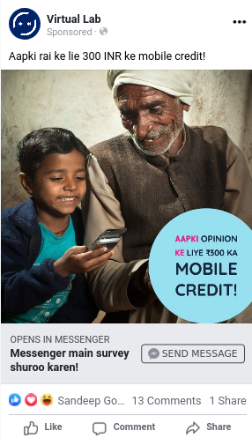

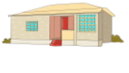
Study 1: Why stratified sampling is important?
We incentivize survey completion with mobile credit ($3.5)
Questions:
Did the campaign work?
Did the campaign work for those most at risk of malaria?
Concern: those most at risk are underrepresented on social media
Solution: target recruitment ads at those most at risk
have 2X malaria incidence and are less represented on FB compared to
Non-Solid dwellings
Solid dwellings
“Lookalike Audience” to increase share of Non-Solid dwellings in the sample
Notes:
Dwelling type is a strong predictor of malaria prevalence

Slide 12
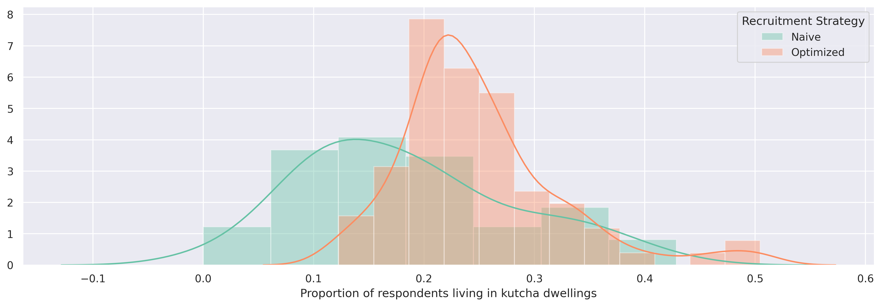
Study 1: Why stratified sampling is important?
Proportion of respondents living in Non-Solid dwellings
Notes:
Why do you think this is the case?

Slide 13
Study 1: Preventative behaviors (during campaign)
DV: Self-reported bed net use among bed net owners (76% of sample)
+3.8% (p<0.10)
NS
+8.5% (p<0.05)
+3.3% (p<0.10)
NS
+10.5% (p<0.01)
n=3900 (overall), 1789 (solid), 2111 (non-solid/semi-solid)
Notes:
The use of bed nets increased for people living in Permanent dwellings, but not for people living in Non-Permanent dwellings, where malaria risk is higher
Family size is similar across dwellings: 6.5 solid, 6.7 non solid

Slide 14
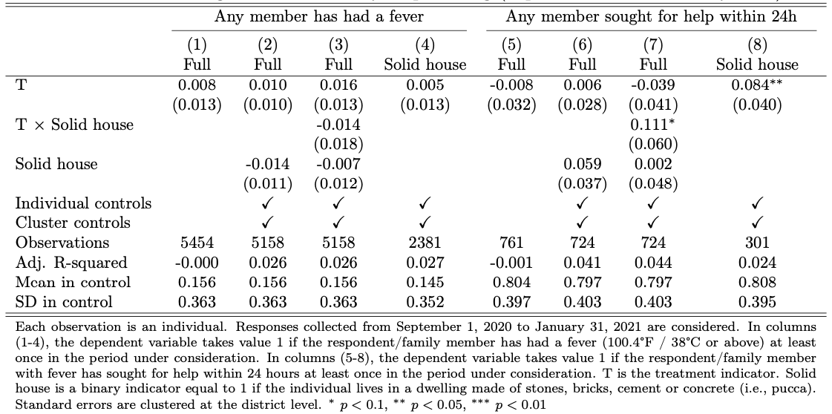
Study 1: Response actions (during campaign)
DV: Have you/someone in your family had a fever (100.4F / 38C or above) in the last two weeks?
If fever: Did you seek medical help within 24 hours?
+10.4% (p<0.05)
Notes:
The use of bed nets increased for people living in Permanent dwellings, but not for people living in Non-Permanent dwellings, where malaria risk is higher

Slide 15
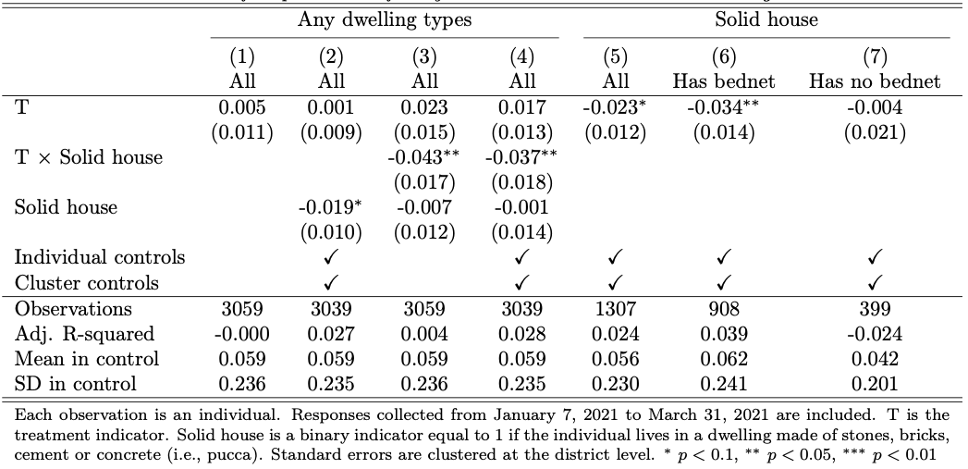
Study 1: Self-reported malaria incidence (1-4 months after campaign)
DV: Have you/someone in your family had Malaria since last August?
41-54% reduction in self-reported incidence
Notes:
The use of bed nets increased for people living in Permanent dwellings, but not for people living in Non-Permanent dwellings, where malaria risk is higher

Slide 16
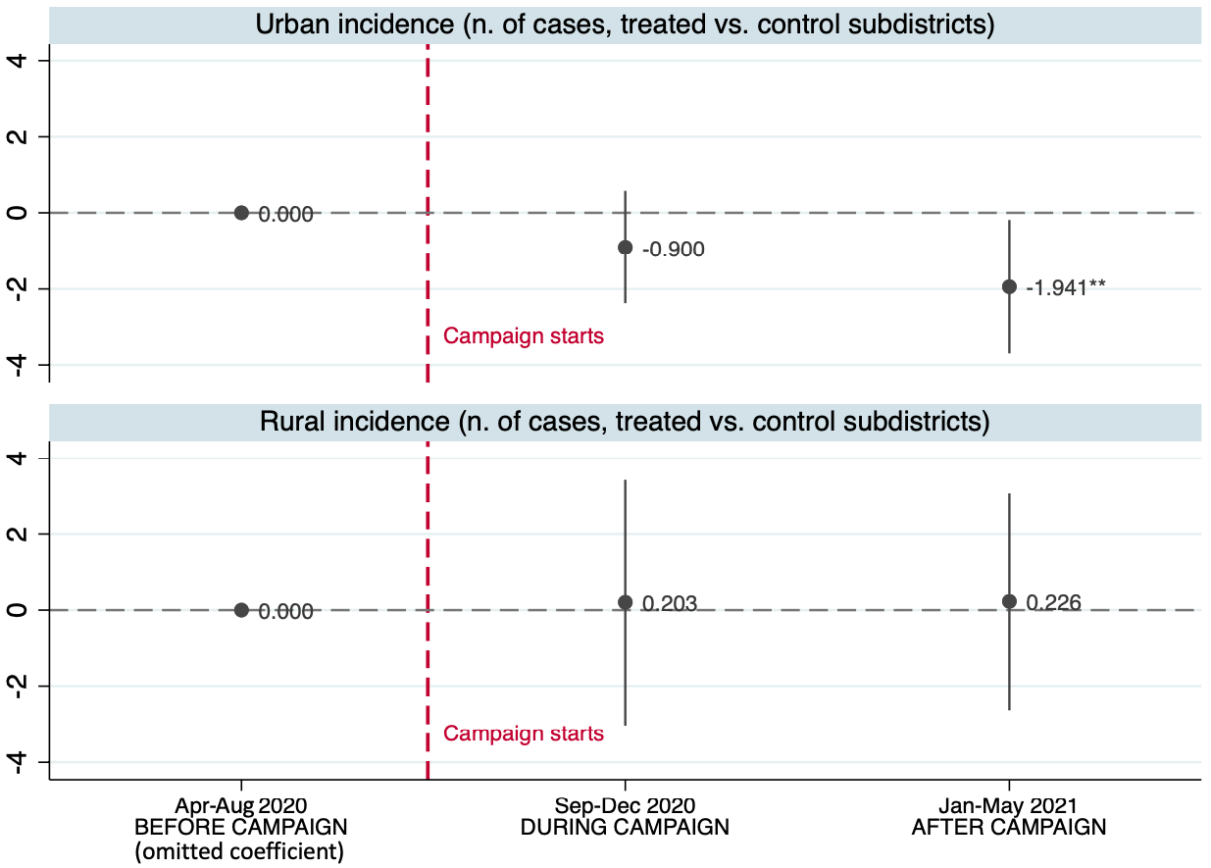
Recorded malaria incidence (monthly cases per subdistrict)
We use administrative health facility data on malaria cases (split by urban/rural)
Difference-in-Differences model (treatment/control X before/after)
85% of dwellings are solid
Reduction in urban cases account for 23% of overall incidence at baseline
No impact on rural incidence
~50% of dwellings are solid
Notes:
Should we also control for n. of tests?

Slide 17
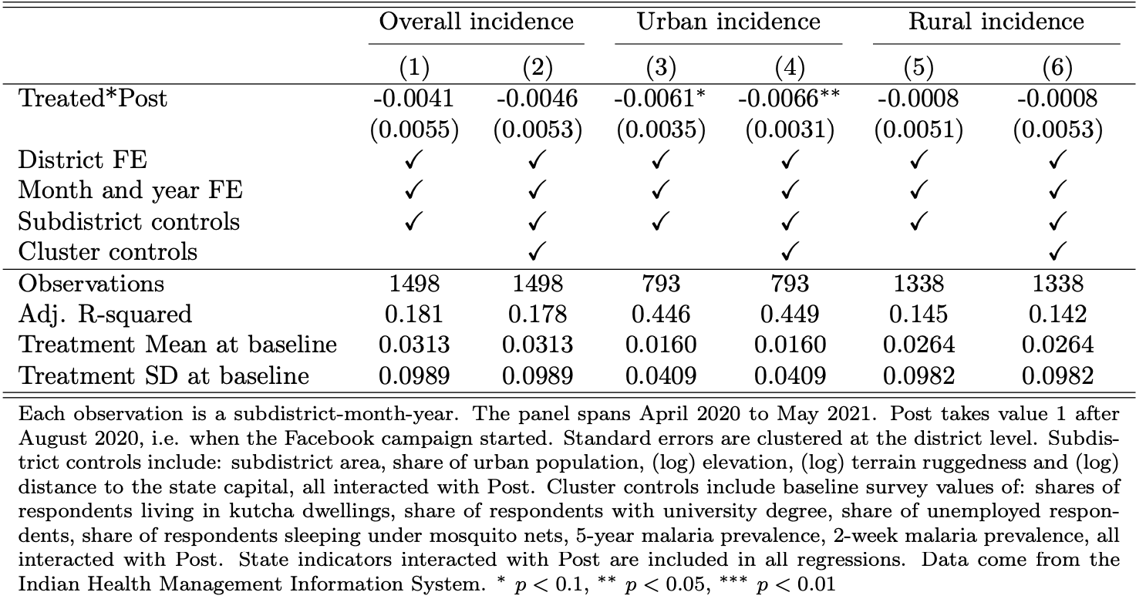
Recorded malaria incidence (monthly cases/1,000 people)
41% reduction compared to pre-treatment period
No impact on rural incidence
Notes:
Should we also control for n. of tests?

Slide 18


Persuasion vs. Targeting
Lack of persuasion: Ad material was not effective for individuals living in Non-Solid dwellings
Lack of targeting: Ad campaign did not reach those living in Non-Solid dwellings
Ad recall data: 50% increase in ad recall only among respondents in Solid dwellings
Study 2: Individual-level feed experiment to keep targeting constant
Notes:
Did not persuade

Slide 19
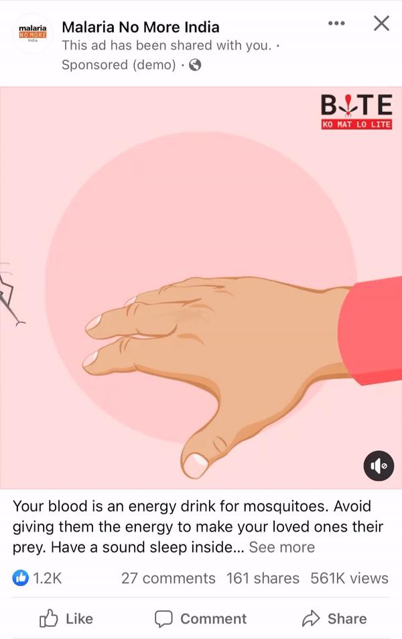
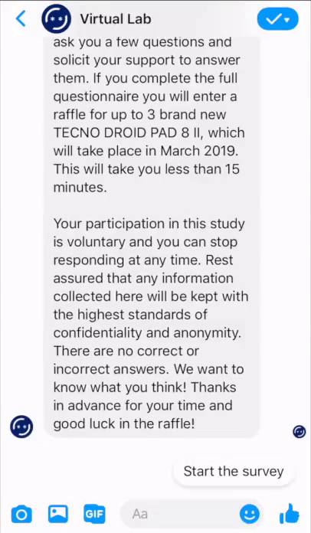

Study 2: Individual-level feed experiment
Randomize and re-market content (2 weeks)
Recruit respondents + baseline survey
Break
Follow-up survey
2 weeks
No Ad
→ Record FB IDs for tracking
→ Ask about bed net use
n=1,300

Slide 20
Study 2: Findings
+11% (p<0.05)
+10% (p<0.10)
+14% (p<0.10)
No heterogeneous treatment effects across dwelling type
Ad content is effective for all individuals
Ad campaign did not sufficiently reach those living in Non-Solid dwellings

Slide 21
Cost-effectiveness
Assumption: study states are comparable to the remaining 19 states (mid/high malaria burden, bednet distribution programs, high population, good FB penetration)
Cost per case averted: $3.1 (urban cases) – $4.5 (overall)
1.1 B people in 22 states
Avoided (recorded) cases attributed to the campaign (Sep 2020 to May 2021):
41.4 per M people (overall) - 59.4 per M people (urban areas)
Cost of campaign: 202,000 USD
Could fall under $0.25 considering that estimated cases are 20X reported cases
Cost-effectiveness of programs that distribute Insecticide-Treated-Nets: $5-6 (Conteh et al. 2021)
Notes:
Support the assumption
Add estimated cost-effectiveness from literature
45,540 total averted cases
65,340 total averted cases

Slide 22
Conclusions and implications
Social media Ad campaigns are a cost-effective way to achieve public health objectives
Yet they affect subpopulations differently
Higher reach among urban and richer populations, where engagement is also high
But these populations are less at risk of disease
→ Ad-delivery algorithm can limit campaign effectiveness (e.g., optimize engagement)
Micro-targeting techniques can help maximize impact in subpopulations of interest
Scalable approach to identify underrepresented communities and target them via lookalike audiences
Open-source toolkit (Rao and Donati 2023 WP)
Notes:
MNM campaign objective was Engagement

Slide 23
Thank you!
dd3137@gsb.columbia.edu www.vlab.digital

Slide 24
Appendix

Slide 25
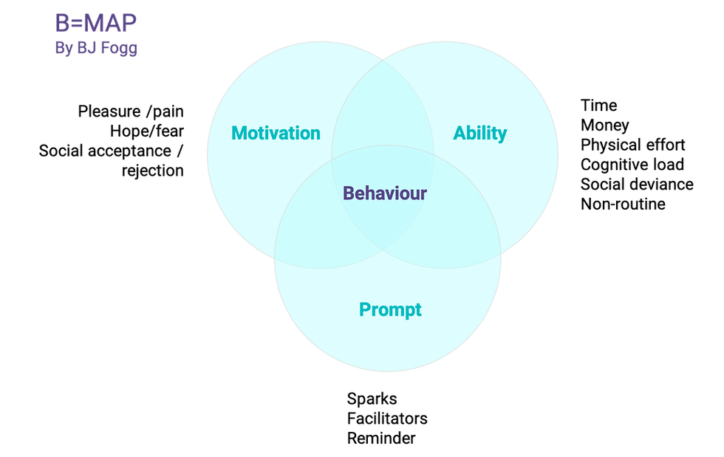
Theory of change (based on Fogg, 2009)
Goal: Adopt protective action against a risk (e.g., malaria)
Information about a threat is not sufficient to trigger action
Notes:
For each persona, barriers to preventative and response behavior were identified, and content was developed based on insights from their online behavior.
1) Motivation to act: whether it is caring for one’s family, looking after one’s children, or oneself
2) Ability: Identifying a preventative and response action that might be feasible to implement even with existing barriers to implementation -seek treatment when fever is present, sleep under bed nets;
3) Provide a clear opportunity for action and highlight the cost of inaction

Slide 26
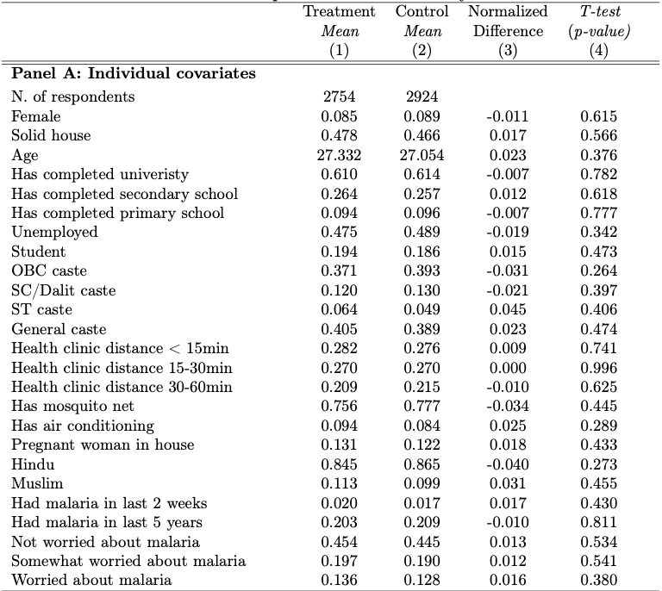
Study 1: Balance test
Notes:
Maybe add subtitles in the balance table: upper panel (Socio demographic characteristics) and lower panel (Malaria outcomes)
I would bring up religion and edit a bit the education variables (Has completed as title> different levels as sub-titiles) and caste (spell out acronyms for folks not familiar with the caste system)
I would add a similar red lined box for the normalized difference (and maybe a footnote explaining its 0.25 threshold) as it also shows solid pre-treatment balance.
Shouldn’t we also have a balance table (or separate panel) for the HF data?

Slide 27
Study 1: Why stratified sampling is important?
Proportion of respondents living in Non-Permanent dwellings
Notes:
Why do you think this is the case?

Slide 28
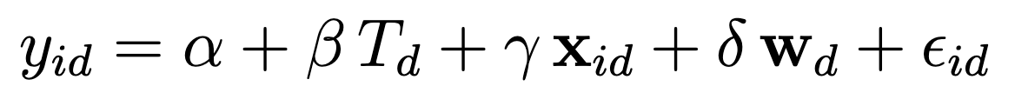
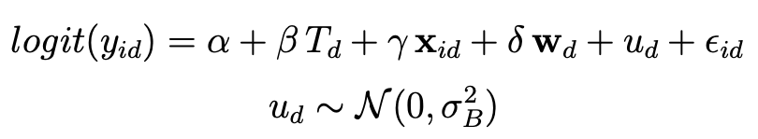
Study 1: Empirical specifications
Most outcomes are binary, and observations are grouped
Linear Probability Model, estimated via OLS:
Standard errors clustered at district level
Binomial random-effects model, estimated via ML:
District random coefficients
Estimated on the entire sample and on each dwelling type, separately.

Slide 29
Study 1: Preventative behaviors (during campaign)
Heterogeneous treatment effects by perceived risk of malaria at baseline
How worried are you that you/someone in your family will get malaria in the next month?
Notes:
The use of bed nets increased for people living in Permanent dwellings, but not for people living in Non-Permanent dwellings, where malaria risk is higher

Slide 30
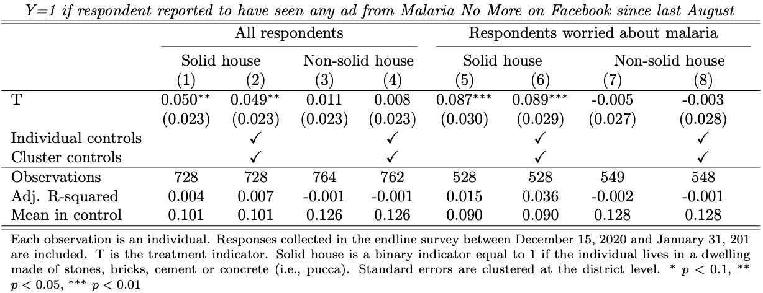
Ad/brand recall (at the end of campaign)
DV: Since August of this year, have you seen any advertising from Malaria No More on Facebook?
Notes:
Did not persuade

Slide 31
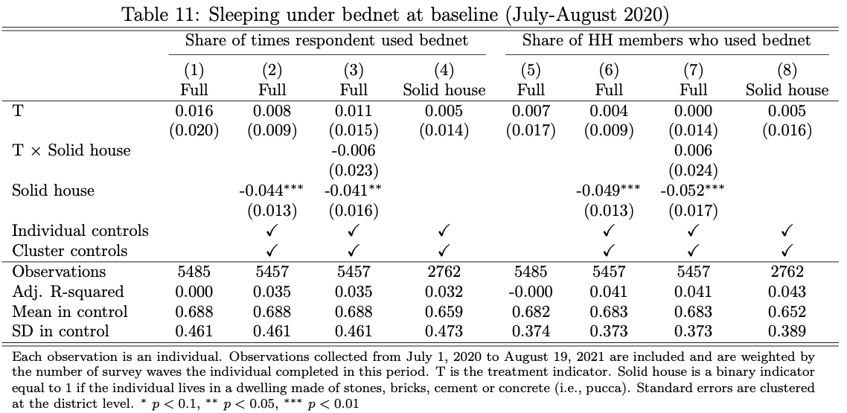
Sleeping under bednet at baseline (July-August 2020)
Notes:
broadly consistent with the reduction in uncomplicated clinical episodes observed in earlier efficacy studies,

Slide 32
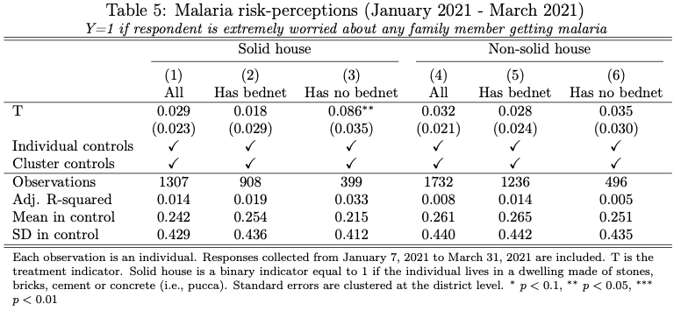
Malaria risk perceptions (Jan 2021 – Mar 2021)
Notes:
broadly consistent with the reduction in uncomplicated clinical episodes observed in earlier efficacy studies,

Slide 33
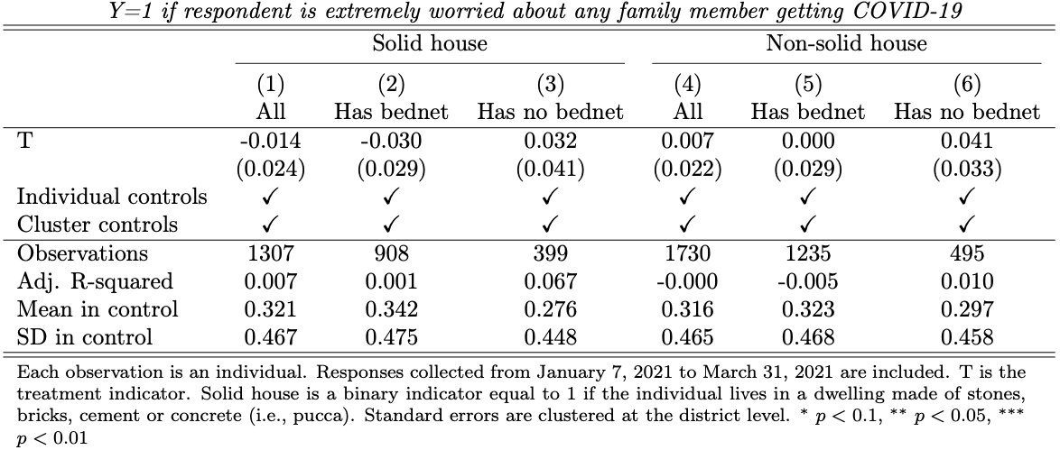
Covid-19 risk perceptions (Jan 2021 – Mar 2021)
Notes:
broadly consistent with the reduction in uncomplicated clinical episodes observed in earlier efficacy studies,

Slide 34
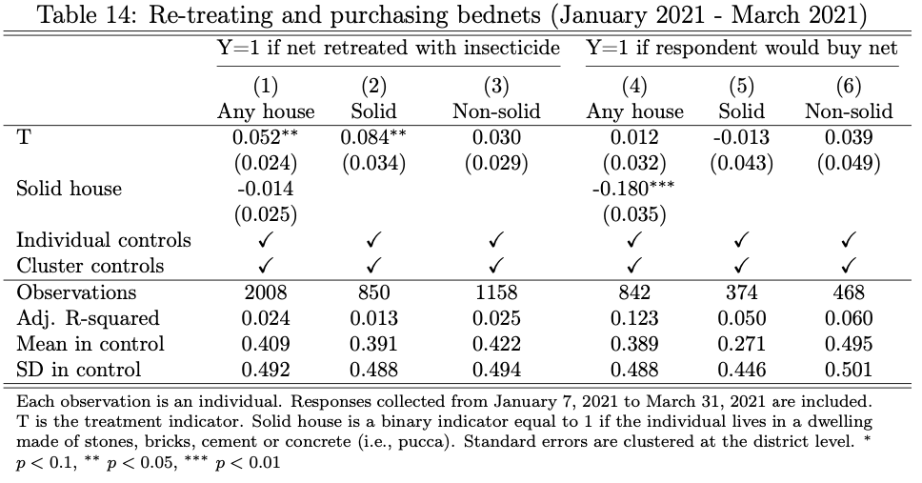
Re-treating and purchasing bednets (January 2021 - March 2021)
Notes:
broadly consistent with the reduction in uncomplicated clinical episodes observed in earlier efficacy studies,

Slide 35
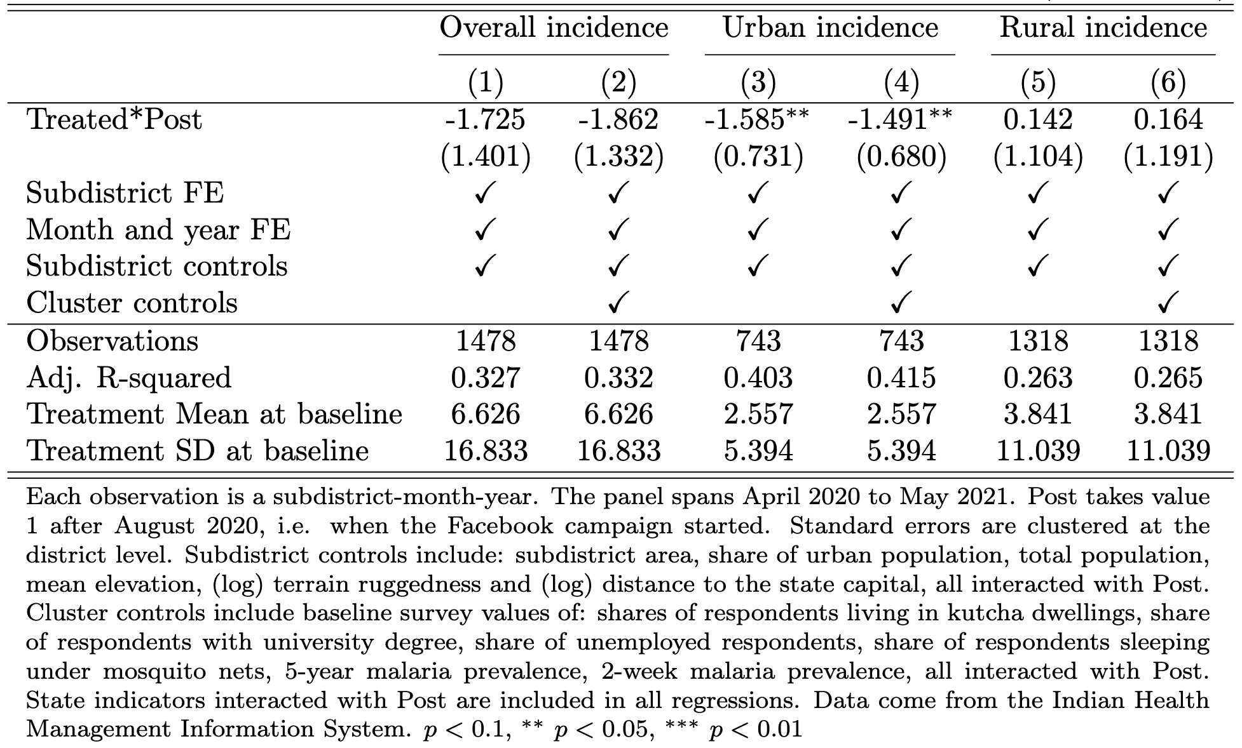
Malaria Incidence (n. of monthly cases per subdistrict)
Reduction in urban cases account for 22% of overall incidence at baseline
Relative risk ratio: 0.77
No impact on rural incidence
Notes:
broadly consistent with the reduction in uncomplicated clinical episodes observed in earlier efficacy studies,

Slide 36
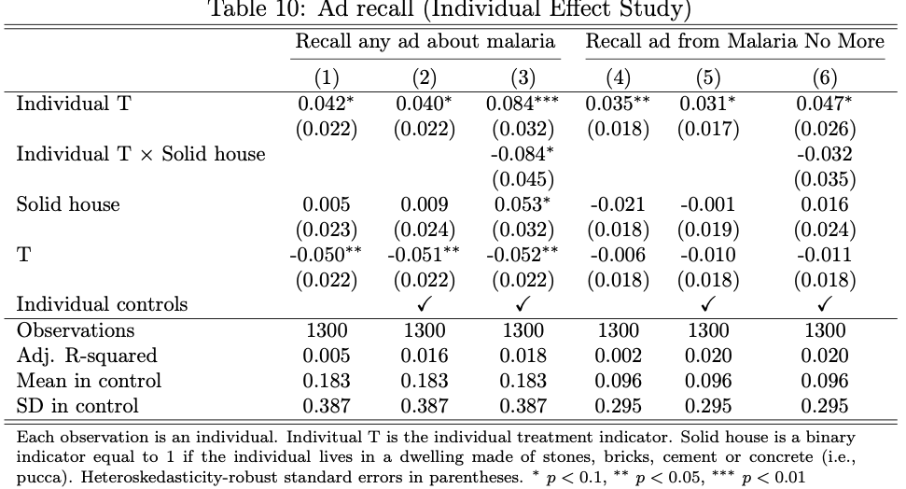
Ad recall (Individual Effect Study)
Notes:
broadly consistent with the reduction in uncomplicated clinical episodes observed in earlier efficacy studies,

Slide 37
Ad content
50+ different creatives
Persona-specific content (e.g., gender, age, urban)
Informed by behavioral theories (motivation, ability and opportunity to act) and formative research
Notes:
For each persona, barriers to preventative and response behavior were identified, and content was developed based on insights from their online behavior. For example, for women, who tended to emphasize family and protection against mosquitoes, content focused on children and motherhood. For men, who were more focused on information, content focused on services (government, healthcare), symptoms and treatment. Younger audiences, especially in the 18-24 age bucket were targeted using meme-styled content and humor, and older individuals, received content that used their awareness and engagement with the topic to spread the word and advocate for prevention and response, for example, by encouraging grandparents to have their grandchildren tested if they experience malaria symptoms.

Slide 38
Can Facebook Ads prevent malaria?
It depends…
…on the subpopulation of interest

Slide 39
Study 2: Findings
After 2 weeks from Ad exposure
7 pp (p<0.01) increase in the probability of sleeping under bed nets
No heterogeneous treatment effects across dwelling type
For bed net use:
Ad content itself is effective for all individuals
Ad campaign did not sufficiently reach those living in Non-Solid dwellings (i.e., those most at risk)

Slide 40
Study 1: Preventative behaviors (during campaign)
DV: Self-reported bed net use among bed net owners
+3.8% (p<0.10)
NS
+8.5% (p<0.05)
+3.3% (p<0.10)
NS
+10.5% (p<0.01)
Notes:
The use of bed nets increased for people living in Permanent dwellings, but not for people living in Non-Permanent dwellings, where malaria risk is higher
Family size is similar across dwellings: 6.5 solid, 6.7 non solid

Slide 41
Study 1: Did the Ad campaign work?
DV1: Sleeping under bed nets
DV2: Seeking for medical attention
DV2: Self-reported malaria incidence (over the last 6 months)
No/Little overall effects of the campaign
Yet, significant heterogenous treatment effects across dwelling type
+ 6.3 pp (p<0.01) in bed net usage + 8.7 pp (p<0.05) in seeking for help in case of high fever - 3.3 pp (p<0.05) in self-reported malaria incidence
No effect
Notes:
The use of bed nets increased for people living in Permanent dwellings, but not for people living in Non-Permanent dwellings, where malaria risk is higher

Slide 42
Aug
(omitted coefficient)

Slide 43
Study 1: Campaign impact evaluation design
Control districts (no Ads)
Treatment districts (Ads)
Notes:
Why do you think this is the case?

Slide 44
Study 1: Timeline
Administrative data
Phase 1 of data collection
Phase 2 of data collection
Individual-level study
Panel sample
Recruitment + Baseline
Panel
Endline
Cross-sectional sample
Recruitment + Survey
Experiment + Survey
Experience surveys
(8 waves)
August 2020 January 2021 March 2021 May 2021
Ad campaign is live
Notes:
Why do you think this is the case?

